Slide 1
AMBREEN

Slide 2
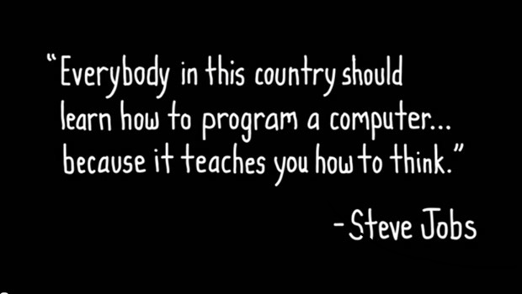

Slide 3
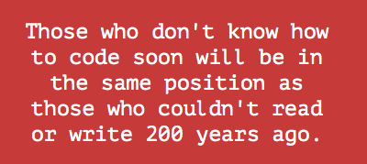

Slide 4


Slide 5
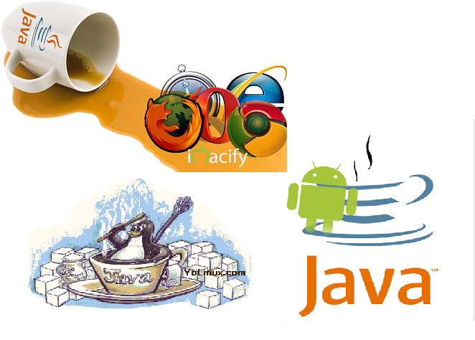

Slide 7


Slide 12

What is the prerequisite ? LOVE
for
programming

Slide 13
How long does it take to learn JAVA
Java is an ocean.
Learning time depends on what you want to learn in Java.
My suggestion for you is go ahead and start coding

Slide 15
